Slide 1
Elevating Excellence in AI-Assisted Development
Notes:
Hi Tony,
I’m Katie Peters, and I’m a Developer Advocate on the Engineering Productivity team within the newly created Platform Engineering & Common Services organization. You approved the founding of our team last year and our continued expansion, and we know we come with some expensive assets. So we wanted to take this time to show you what we’ve done with your investment, and what we plan to continue doing.
Our reason for being is to bring focus, flow, and joy to TELUS developers, which coincidentally also reduces costs and drives capital efficiency. We believe that this mission is critical to our success as a global technology company. If we believe in our TELUS social purpose, it truly starts at home with enabling happiness at work. But besides the intrinsic value of helping humans be happy, happiness in the workplace makes good business sense. Happy humans are likelier to be more energized, more creative, and get more work done. Multiple studies have found that happy workers are more productive; 13% more productive, according to Oxford University.
We already have a winning culture in terms of flexibility, work-life balance, social and environmental purpose, equity and a respectful workplace, and purposeful, impactful work. But we routinely hear in pulse-check results in CDO that our developers have to go through too many painful and unclear processes to get their work done. This impedes their productivity, but it also seriously impacts their happiness at work. This likewise impedes our ability to recruit and retain digital talent.
So today, we want to show you a picture of what it’s like as a Developer at TELUS, and what we are doing about it.

Slide 2
1. Introduction & Responsible AI
2. Fuel iX
3. Github Copilot
4. Advanced AI Dev w/ VSCode + MCP + Cline
5. Art of the possible with Cursor

Slide 3
responsible AI usage
heading
✨1. Don’t use AI simply for the sake of using AI. If you’re using AI tools as a crutch or substitute for knowledge, learning, and growth, you’re not using them the right way.
✨2. Read more code than you write. AI tools are capable of generating enormous amounts of code, and it’s more important than ever to verify the quality of the output.
✨3. Copilots aren’t the ones who are going to be on call! Any code you commit, whether generated or not, is code you’re responsible for, in terms of quality and maintenance.
✨4. Don’t use AI to develop something that you’re not capable of validating. The speed comes from being able to automate or speed up tasks that you have deep understanding of.
✨5. Do use AI to iterate rapidly, brainstorm creatively, build iterable code quickly, and curate more of a full-stack understanding of software. Inspect the outputs when it comes to critical path items like security, vulnerability testing, etc.
✨6. Do use approved tools. Don’t blindly trust new models or tools. Fuel iX, GitHub Copilot, Cline and Cursor are some tools we’ll dive into today.
https://www.telus.com/en/about/privacy/responsible-ai
https://www.telus.com/en/brand-resources/guides/ai-telus

Slide 4
Fuel iX Access
Web (SSO)
API (Apigee Flow)
https://app.fuelix.ai
Notes:
Santiago

Slide 5
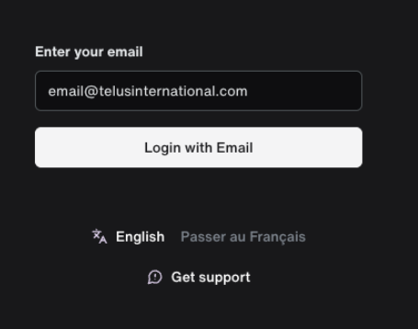
Fuel iX Website
Website: https://app.fuelix.ai
Login using either your telusinternational.com or telus.com email.
Keep in mind that if you want to share a copilot to a specific user, that user needs to be in the same domain.

Slide 6
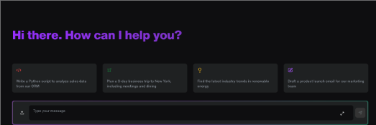
Fuel iX Website
Capabilities:
Fuel iX copilot

Slide 7
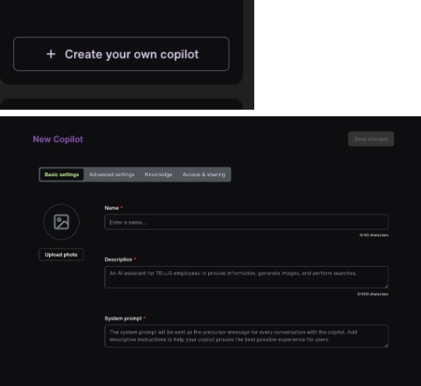
Fuel iX Website
Custom copilots /

Slide 8
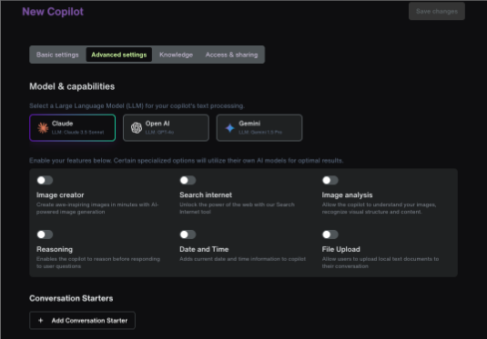
Fuel iX Website
Custom copilots / continued

Slide 9
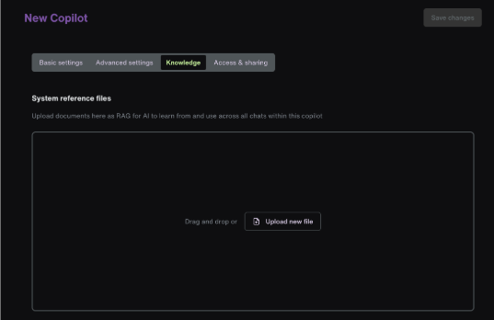
Fuel iX Website

Slide 10
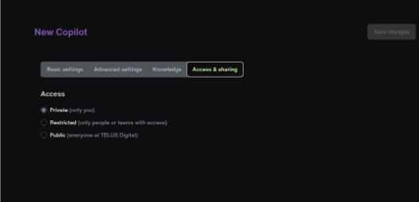
Fuel iX Website
Custom copilots

Slide 11
Fuel Demo
Notes:
Santiago

Slide 12
Github Copilot
Notes:
Santiago

Slide 13
GitHub Copilot Access
heading
How do I get access to GitHub Copilot @ TELUS?
Confirm you're in the right GitHub org (ex. github.com/telus is the main TELUS GitHub org) that has automated copilot onboarding. It’s as easy as filling in this form and you will get access right away
Otherwise, get in contact with your org owner to enable access for you
Download Github Copilot on VSCode
Login using your approved account
Note: You will lose access after 30 days of inactivity to save up on license costs. To regain access simply fill in the form again
Note: If you are working on VPN, then remember to add the proxy url in your IDE settings. For example: in VS Code settings.json file have the ip/port configured to: "http.proxy": "http://198.161.14.25:8080"
Helpful videos and documentation to get started
Grok GitHub - Copilot
Getting started with GitHub Copilot | Tutorial
Onboarding Instructions

Slide 14
GitHub Copilot
heading
✨ GitHub Copilot is an AI-powered coding assistant that helps developers write code faster and act as their virtual pair programmer.
GH Copilot: Real-time code suggestions as you type, offering line-by-line assistance during active coding as well as the ability to switch to Edit mode for multi-line and multi-file edits
GH Copilot Chat: Interactive dialogue system for discussing code changes and problem-solving, like having a conversation with an AI developer
Copilot Workspace: Task-focused environment for planning and implementing complex, multi-file changes across your entire repository
Can be used in various IDEs such as Visual Studio Code, JetBrains, Eclipse etc. or just as standalone chat
Other helpful use cases of GitHub Copilot:
Can help generate PR description and summary of changes
Help with generating commit messages
Can add as a code reviewer in your IDE or github.com
Go to any repo in your GitHub organization and ask questions about it

Slide 15
Advanced Use Cases
Notes:
Hi Tony,
I’m Katie Peters, and I’m a Developer Advocate on the Engineering Productivity team within the newly created Platform Engineering & Common Services organization. You approved the founding of our team last year and our continued expansion, and we know we come with some expensive assets. So we wanted to take this time to show you what we’ve done with your investment, and what we plan to continue doing.
Our reason for being is to bring focus, flow, and joy to TELUS developers, which coincidentally also reduces costs and drives capital efficiency. We believe that this mission is critical to our success as a global technology company. If we believe in our TELUS social purpose, it truly starts at home with enabling happiness at work. But besides the intrinsic value of helping humans be happy, happiness in the workplace makes good business sense. Happy humans are likelier to be more energized, more creative, and get more work done. Multiple studies have found that happy workers are more productive; 13% more productive, according to Oxford University.
We already have a winning culture in terms of flexibility, work-life balance, social and environmental purpose, equity and a respectful workplace, and purposeful, impactful work. But we routinely hear in pulse-check results in CDO that our developers have to go through too many painful and unclear processes to get their work done. This impedes their productivity, but it also seriously impacts their happiness at work. This likewise impedes our ability to recruit and retain digital talent.
So today, we want to show you a picture of what it’s like as a Developer at TELUS, and what we are doing about it.

Slide 16
VSCode + MCP & Cline
Notes:
Santiago

Slide 17
VSCode & Cline
VSCode and Cline
VS Code is available in SSS
Cline is a VS Code Extension in the marketplace here
Cline guide to install and setup
Installation
VS Code
Cline extension
Setup
Use Fuel iX API key

Slide 18
Cursor
Notes:
Santiago

Slide 19
Cursor
Access to Cursor is provisioned within Cost Centers. Please discuss requests with your manager or leadership group.

